Slide 1


Absolute Distributed Environment
Monitoring System

Slide 2


Slide 3
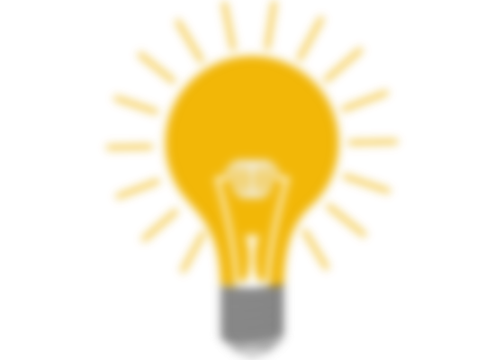
Nowadays, the air quality is considered a key point, and its accurate monitoring is not only suggested but it is even required in many areas. Since traditional standard monitors for air quality are very expensive, the use of a low-cost distributed network of sensors represents a valid complementary approach.

Slide 4
What is ADEMS?

Slide 5

ADEMS is a Absolute Distributed Environment Monitoring System. This Project describes a real-time distributed network that Monitors air quality on a street-by-street level using JavaScript, php, Several libraries of JS, Cloud and IoT.

Slide 6
Why need ADEMS?

Slide 7

Air quality monitoring is a hot topic these days. No wonder, with so many recent studies showing a strong correlation between certain types of air pollution and negative health effects. However, most air quality monitoring happens at a few stations that are few and far between.

Slide 8

What if we used cabs to collect air quality data across the city in near Real Time. On a larger scale (with even more cabs) we could even collect enough data to build pollution maps that let us better understand how pollution may affect some areas more than others.

Slide 9

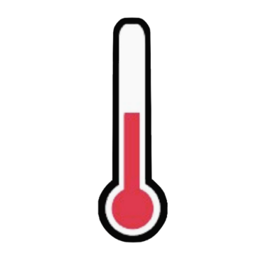
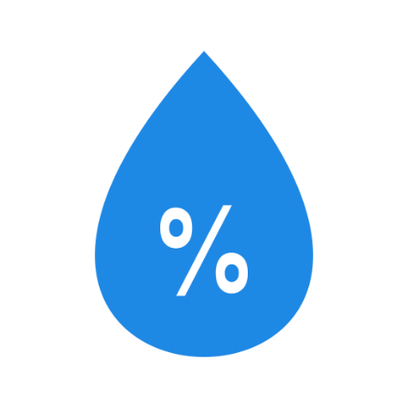
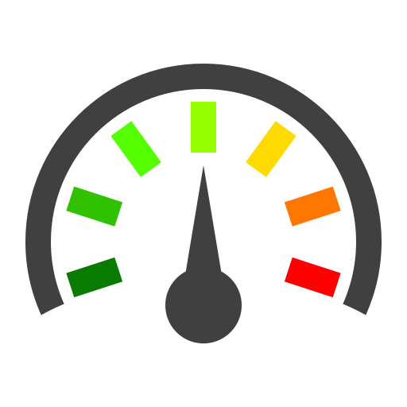
Project Description
In this project we'll be logging:
longitude
latitude
temperature
humidity
pressure
air borne particulate counts (PM10 -PM 2.5)

Slide 10
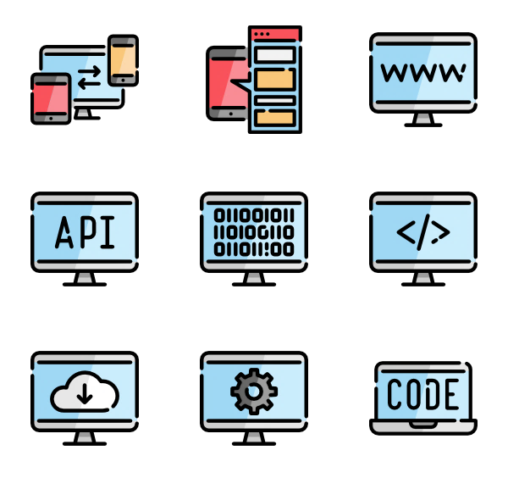
Requirements
Hardware
Software
Arduino
GPS Sensor (Neo M6)
ESP 8266
Jumper Wires
BMP 180
DHT 11
Arduino IDE
Cloud Server
Database

Slide 11
Working

Slide 12
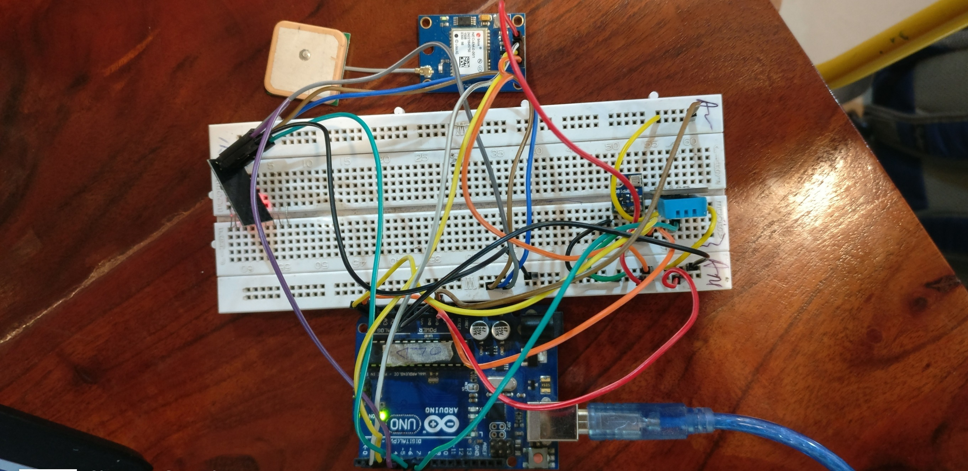

Slide 13
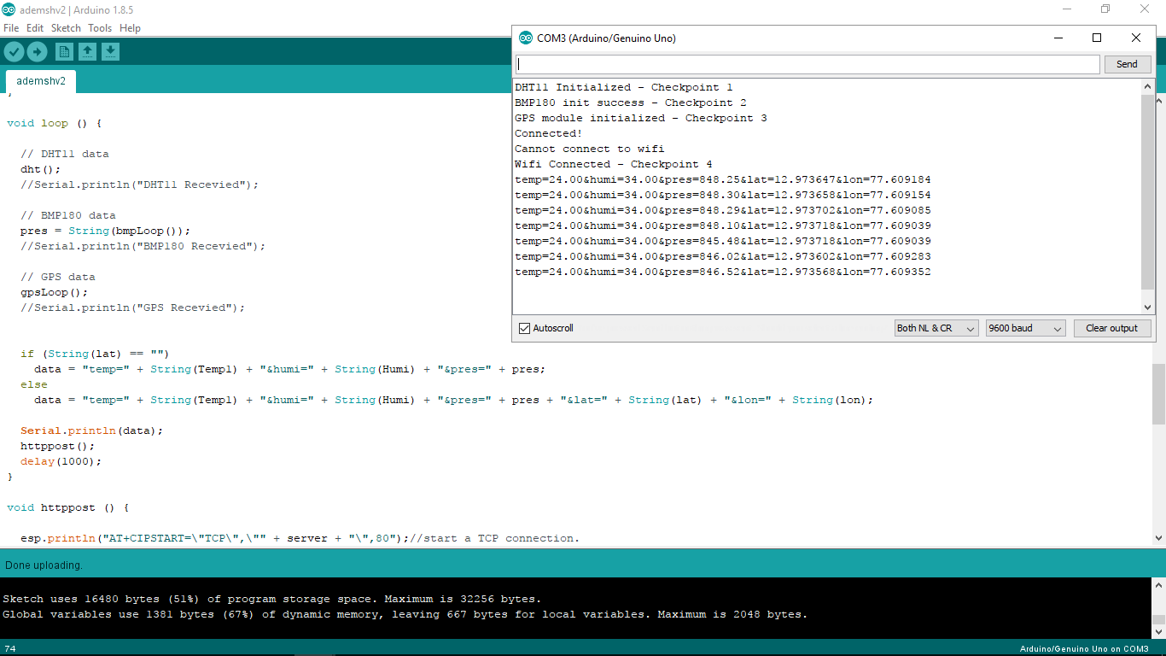

Slide 14
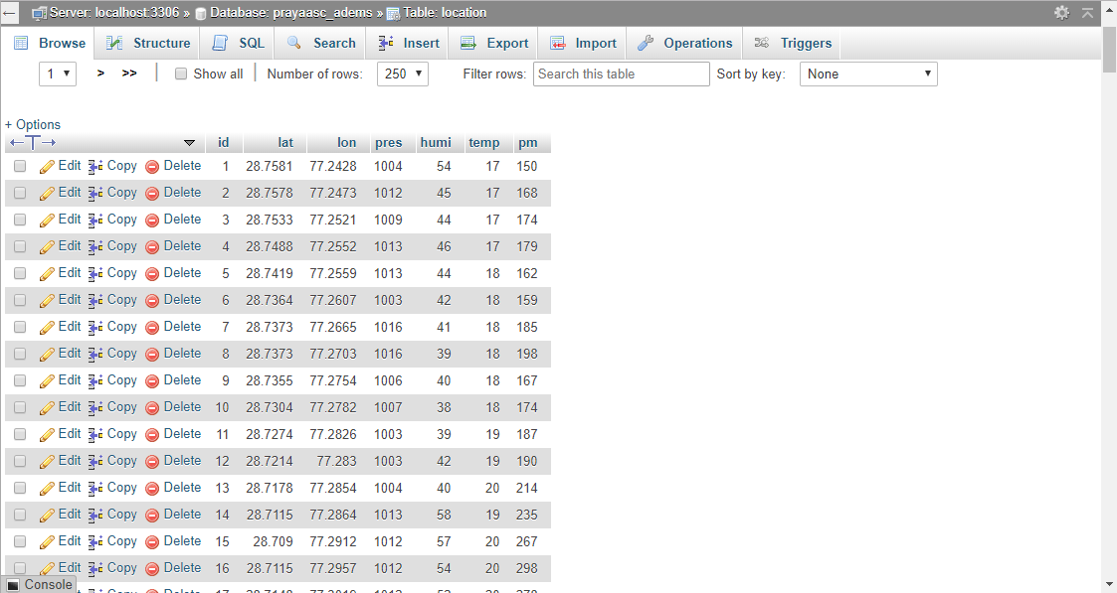

Slide 15
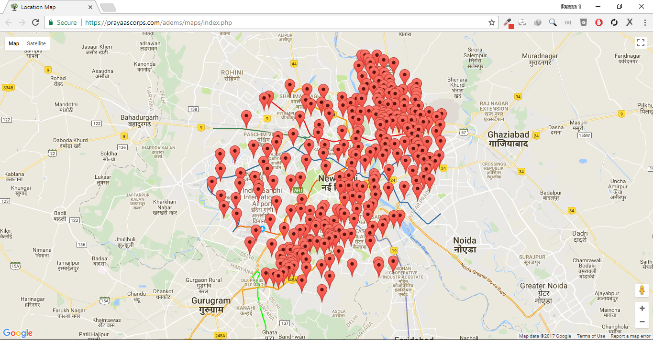

Slide 16
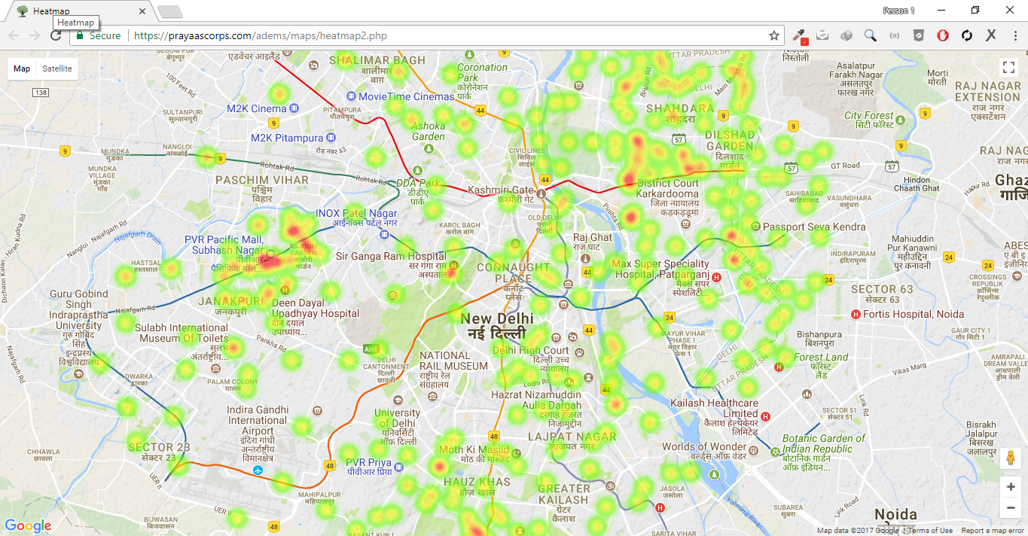

Slide 17
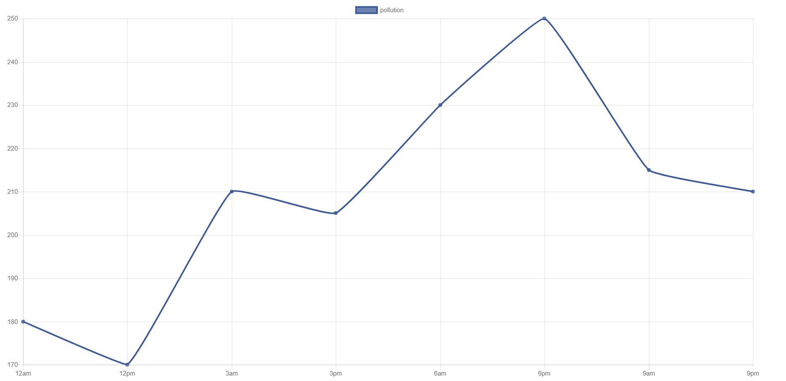
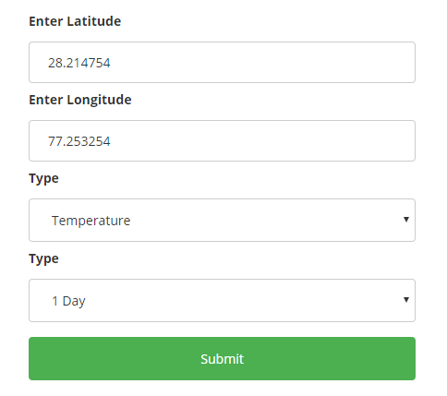

Slide 18
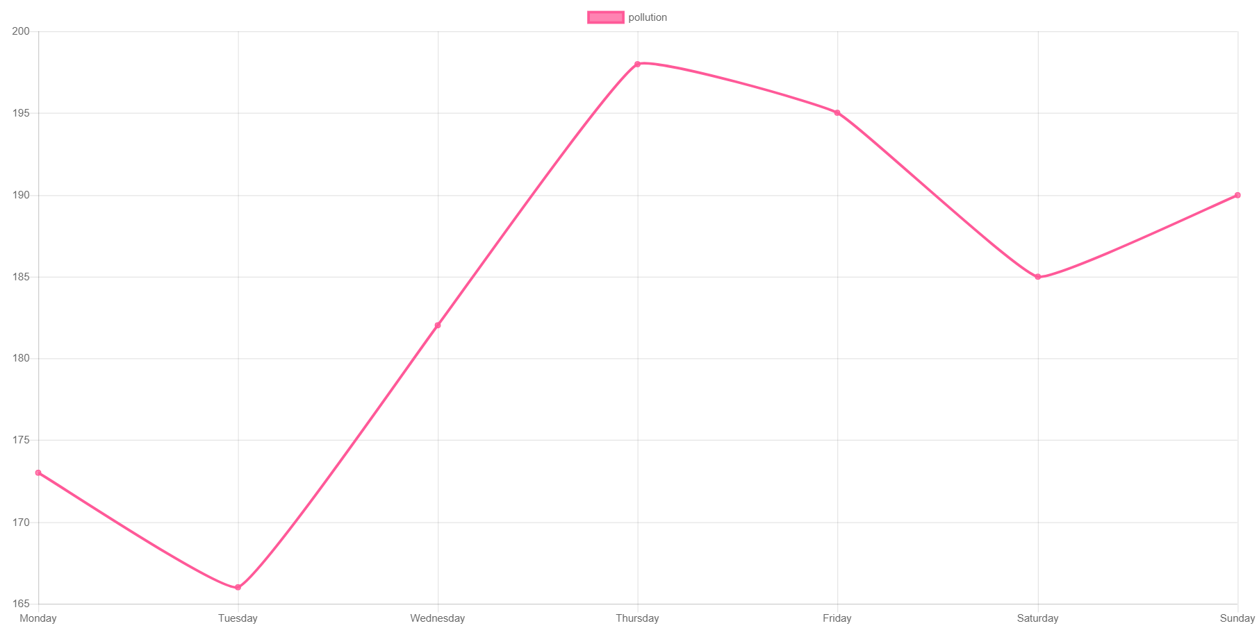
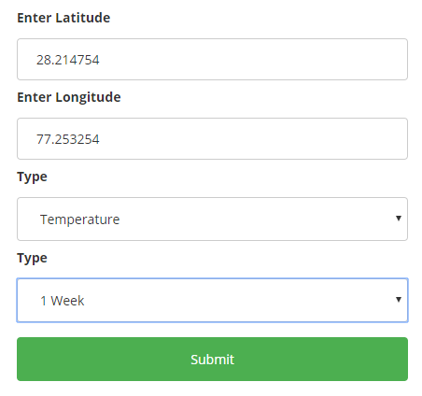

Slide 19
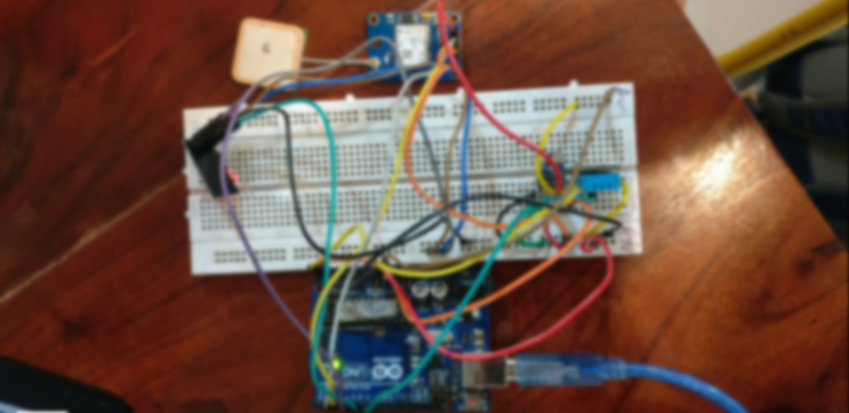

Application
The main application of this project is to analyze and regulate the causes of environmental pollution by collecting a real time absolute distributed data.

Slide 20
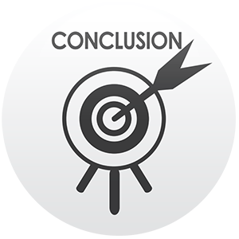
Conclusion
This Project describe a real-time distributed network that Monitors air quality and provide necessary steps to overcome the causes of pollution.
The goal is to provide healthy ambience for generating sustainable environment.

Slide 21

Future Scope
Connect with cloud and perform more analytics.
Our Goal is not just to monitor the data rather use this to refine the measures.
Reduce size in apparatus.

